Slide 1
Architectural Composition and Zeitgeist
Armen S. Sardarov
Doctor of Architecture, Professor,
Dekan of Architectural Faculty of Belarusian National Technical University
The 3rd international conference «ARCHITECTURE: HERITAGE, TRADITIONS AND INNOVATIONS»
February 25-26, 2021 (Moscow)

Slide 2
Time spirit – Zeitgeist as it was called by the great Goethe
What impact does it have on the life of people on the whole, including material and spatial environment of human life-sustaining activity?
What is arranged by architecture in this environment and therefore, does architecture feel and reflect time spirit to the full?

Slide 3
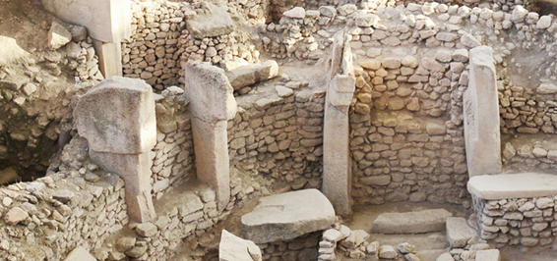
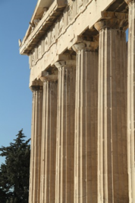
Ancient buildings with used architectural composition
Gobokli-Tepe. Turcey
Parthenon. Greece

Slide 4
Plutarch: “Phalet did the same as the best legislators. His songs advocated for obedience and conformity through melodies and rhythms which contain some organized order” [Vitae parallelae, Lycurgus].
Moreover, it was believed that “discordant and wrong sounds can cause disintegration of the state” [Ib, Agidius]

Slide 5
Epochs of changes in the history of architecture
In architecture as well as in other spheres of life, “order”, “system”, “balance”, “regular recurrence” become important principles and even embody “higher forces” which govern people.
Compositional elements acquire importance in the functioning
of the system:
LIFE OUTLOOK - WORLD PERCEPTION – INDIVIDUAL – SOCIETY.

Slide 6
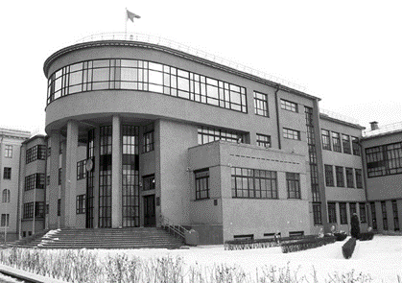
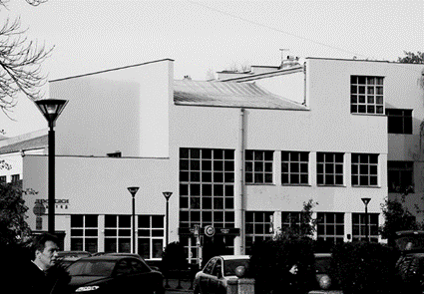
Ideas of XX – XXI centuries
Buildings in Constructivism style. Minsk. Belarus

Slide 7
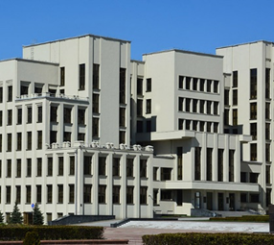
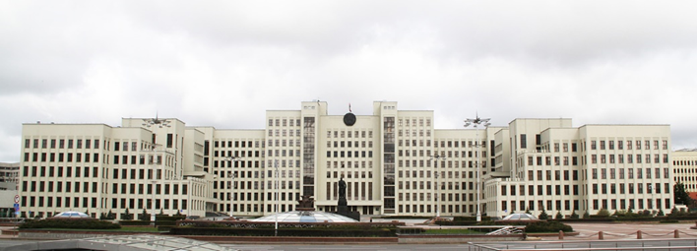
Work of architect Langbard “Government House”. Minsk. Belarus

Slide 8
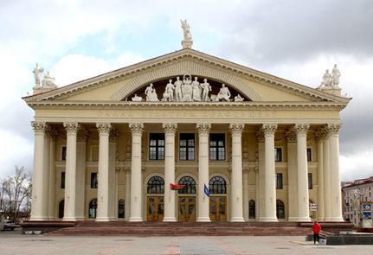
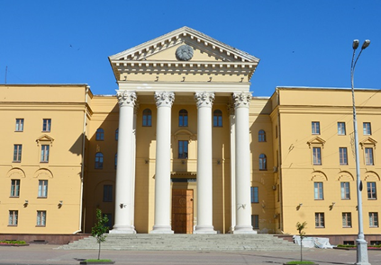
Classic ideas in XX century. Minsk. Belarus

Slide 9
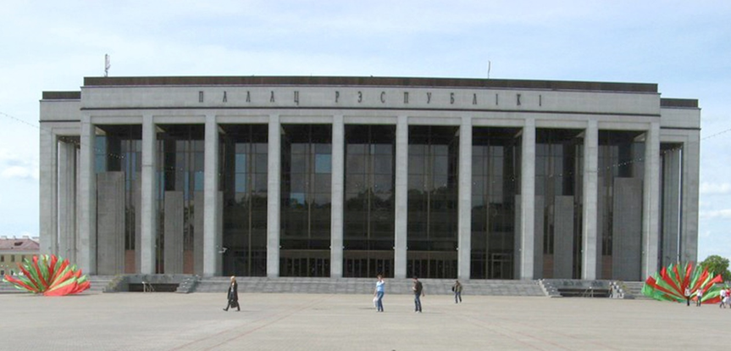
Neo-classic idea in XXI century. Minsk. Belarus

Slide 10
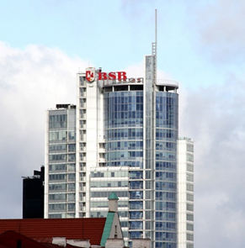
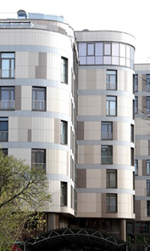
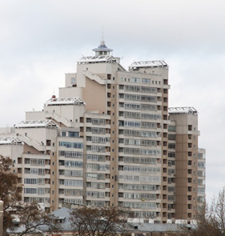
Non – balanced architecture of XXI century. Minsk. Belarus

Slide 11
Conclusion
XXI century with its reevaluation, life outlook and world perception created “spiritual microclimate” for the appearance of new architecture.
Stability and steady rhythm became irrelevant.
The rhythm of window aperture is broken.
Composition of structures loses their balance and creates dynamic tension.
Therefore, by means of symbolic compositional and artistic language architecture once again expresses world perception of its epoch, thus embodying Zeitgeist.

