Slide 1
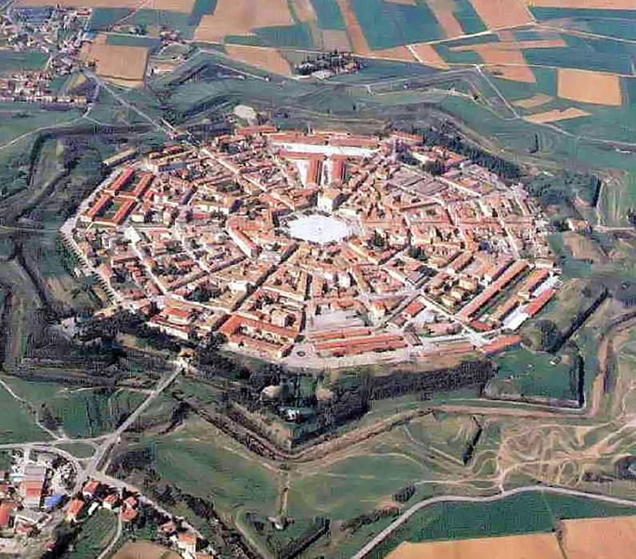
The humanistic ideal city: considerations on the evolution of patterns from 1422 to late 16th century
Andrea Spiriti
Department of Human Science, Innovation and Territory
University of Insubria
Como-Varese, Italy
AHTI 2021 Moscow
March, 10-11

Slide 2
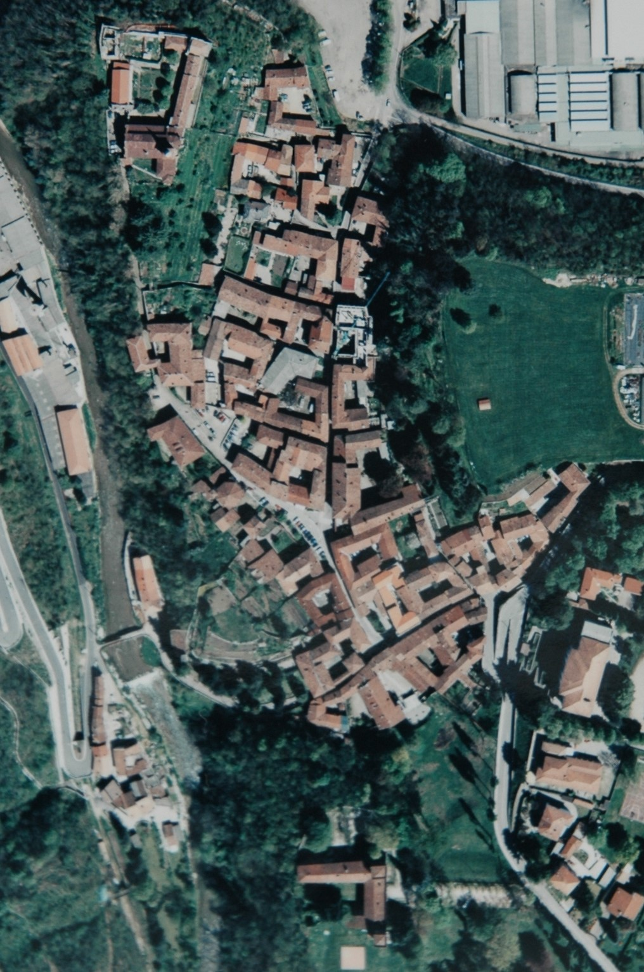
Catiglione Olona, Italy, 15th c.

Slide 3
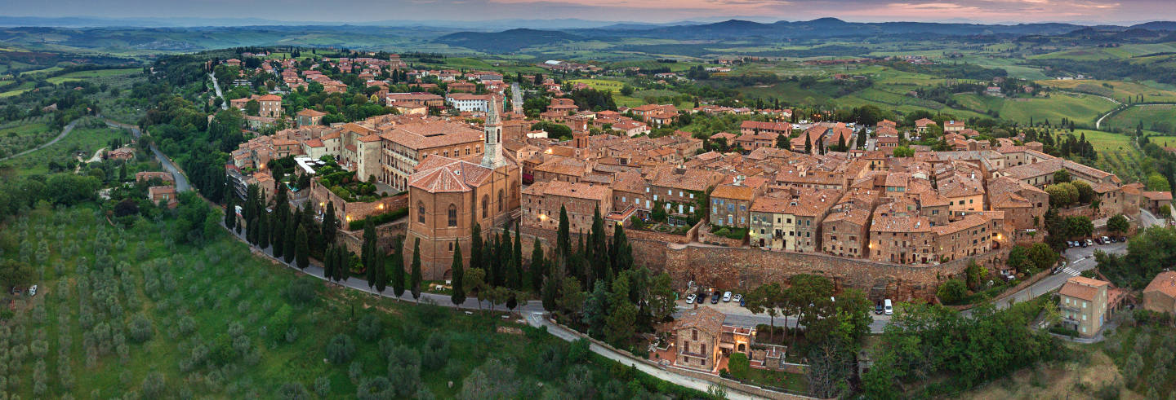
Pienza (former Corsignano), Italy, 1459-1464

Slide 4
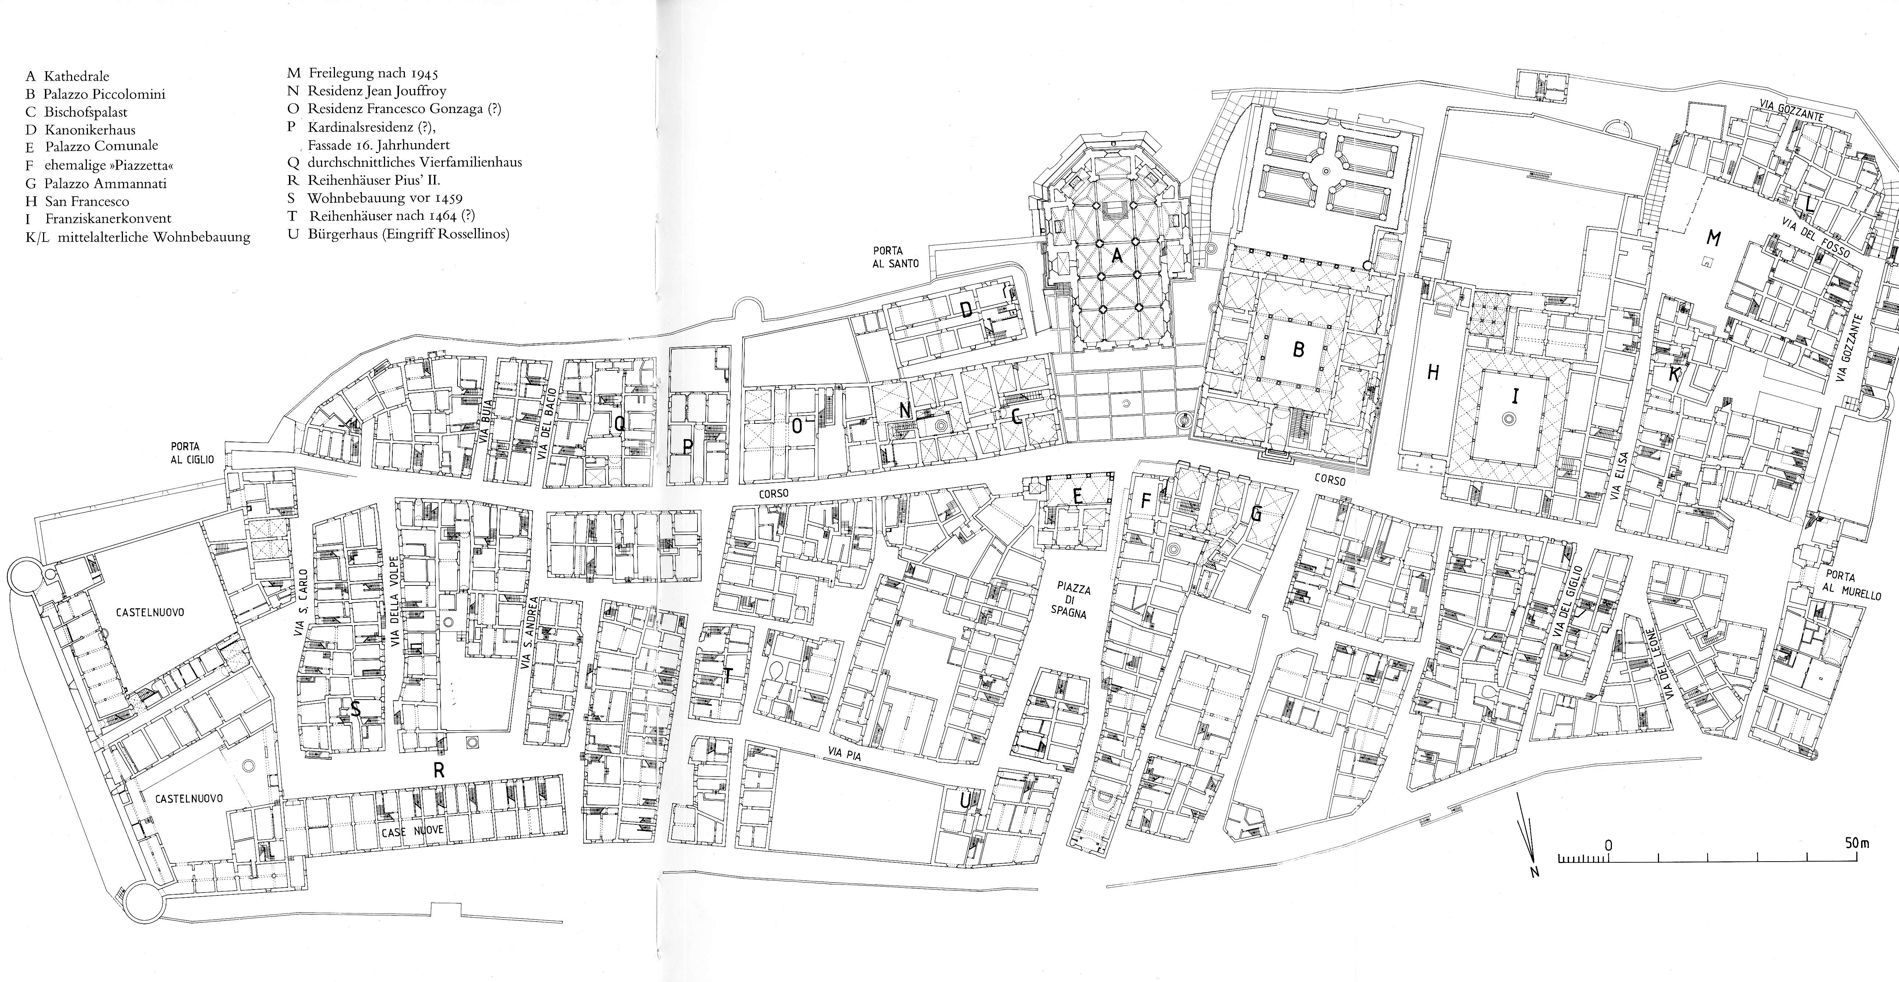
Pienza (former Corsignano), Italy, 1459-1464

Slide 5
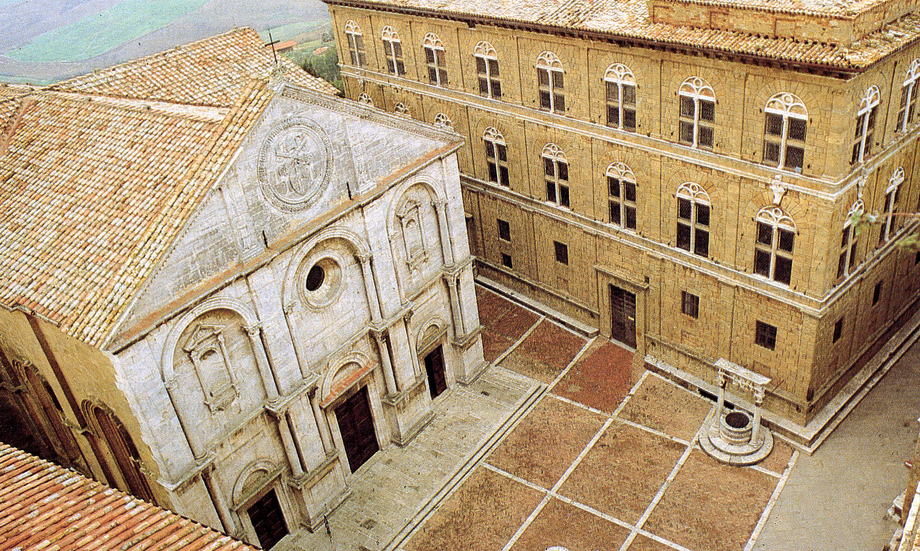
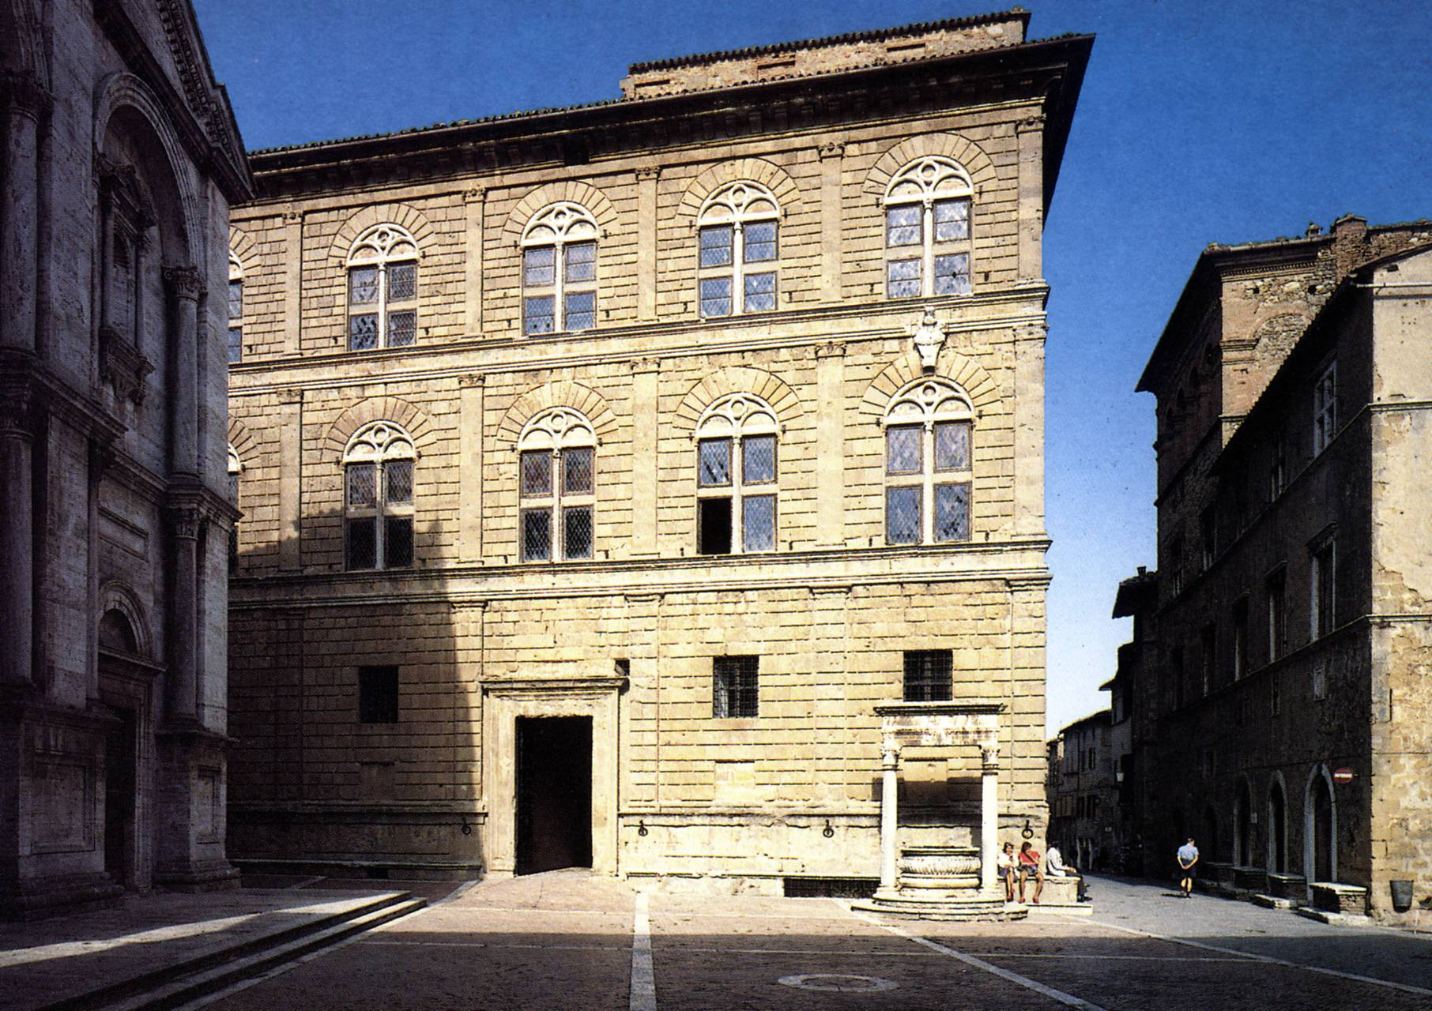
Church and Palazzo Piccolomini. Pienza.
Bernardo Rossellino 1459-1462

Slide 6
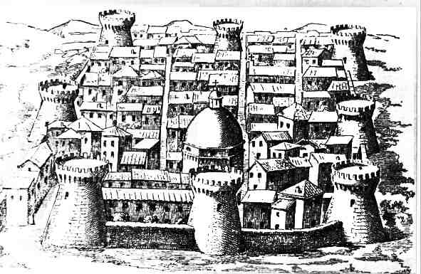
Giulianova, Italy, etching, 16th c.

Slide 7
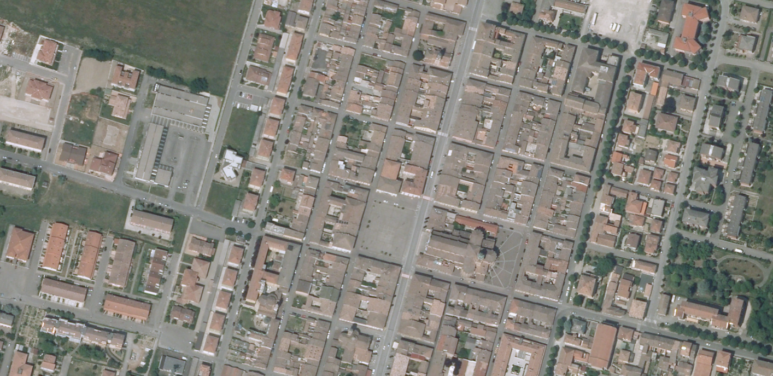
Cortemaggiore, Italy, 1479

Slide 8
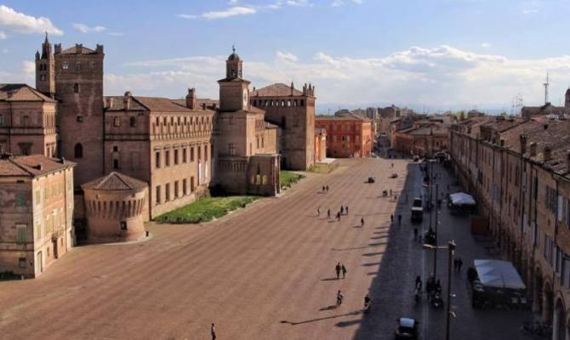
Carpi, Italy, 15th – 16 th cc.

Slide 9
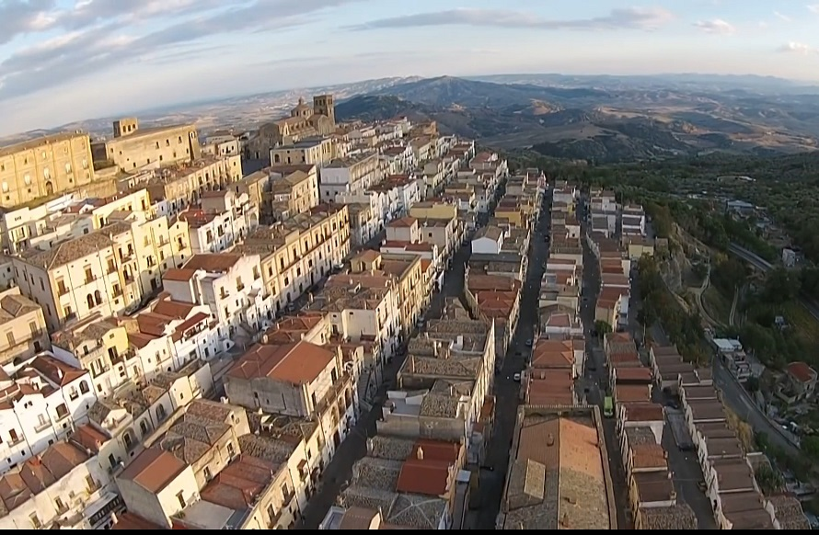
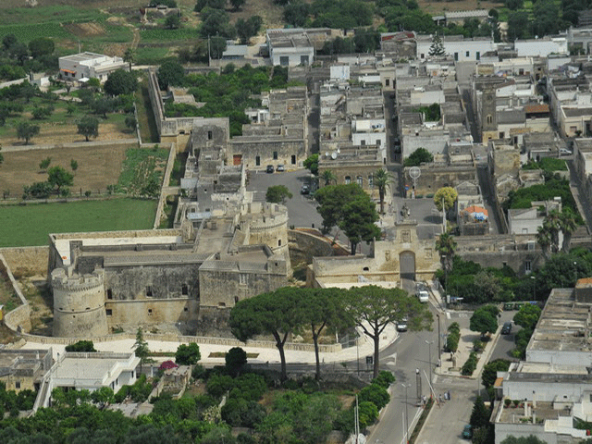
Ferrandina, Italy
Acaya, Italy

Slide 10
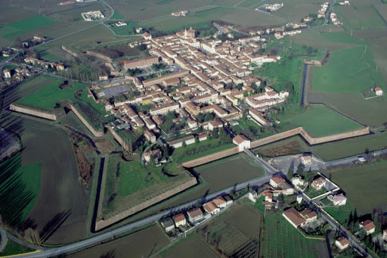
Sabbionetta, Italy, project 1554, built since 1556

Slide 11
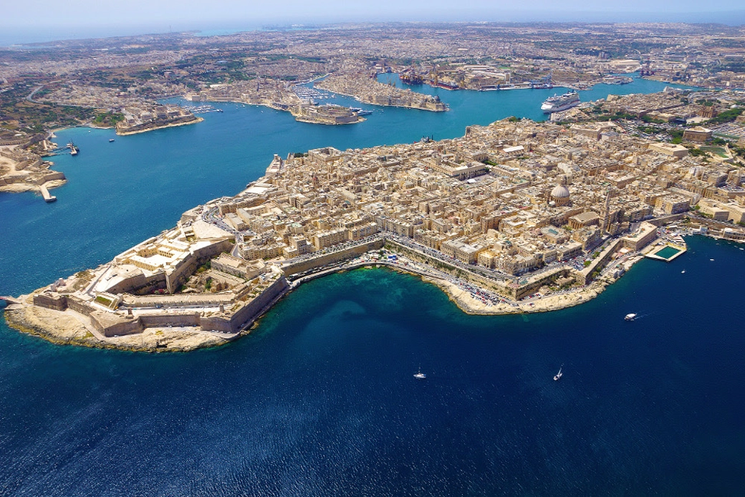
La Valletta, Malta, 1566

Slide 12
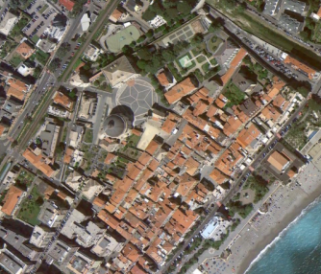
Loano, Italy, 1575

Slide 13
Palmanova, Italy, 1593, project by Giulio Savorgnan

