Slide 1
The Structural Wave.
On "the sincere flattery to technology" and some International Fortune of Italian engineering in the Second half of XX century
Alessandro De Magistris
Department of Architecture and urban Studies Politecnico di Milano
(Milan, Italy)

Slide 2

Towards the golden age of italian engineering
K. Sigel', Struktura i forma v sovremennoj arkhitekture, Stroijzdat, Moskva, 1965.

Slide 3
The decades in which the Italian structural culture stood out, a culture that since the Colonnetti and Danusso's lesson could express itself through the work performed by Nervi, Morandi, Zorzi, Musmeci and other personalities, represented a sort of "Golden Age" to the relationships and interactions between engineering and architecture, marked by the fertilization of the relation between structural visions forms and inventions and architectural expressions

Slide 4
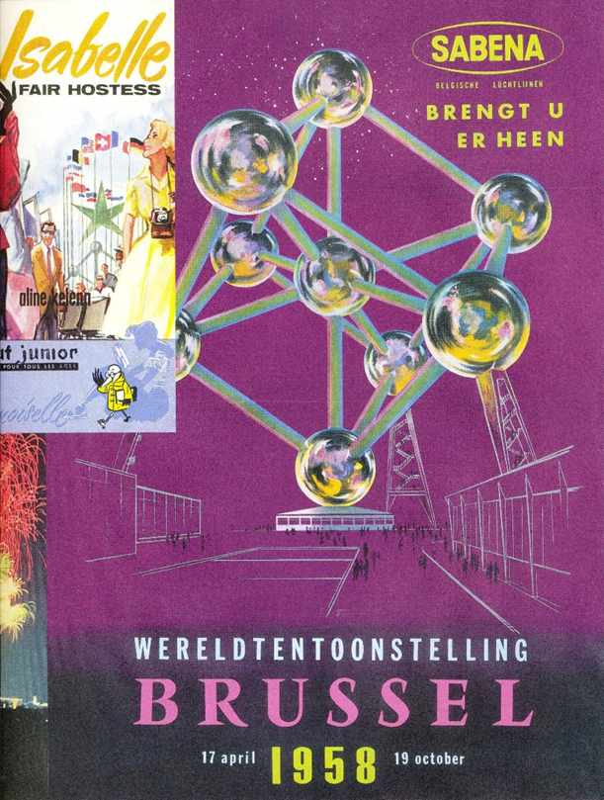
Poster Expo Bruxelles – 1958

