Slide 1
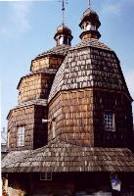
Log roofing of Ukrainian wooden church in the context of world wooden temples space construction
Galyna Shevtsova
Olga Andropova

Slide 2
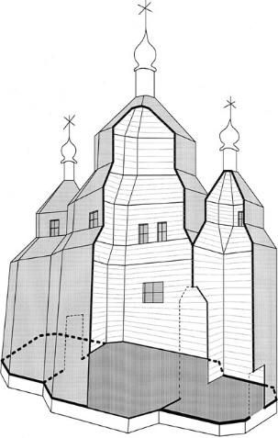
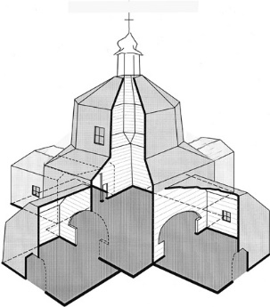
Some examples of Ukrainian log church space structure.
А – cruciform planning with one central tower,
B - three partial panning with three towers.
А
B

Slide 3
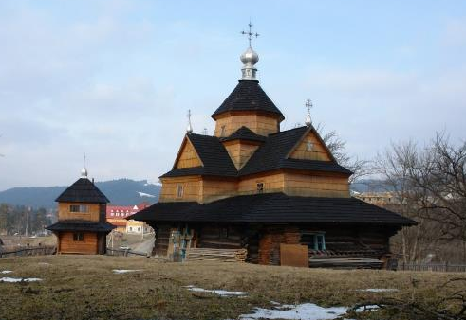
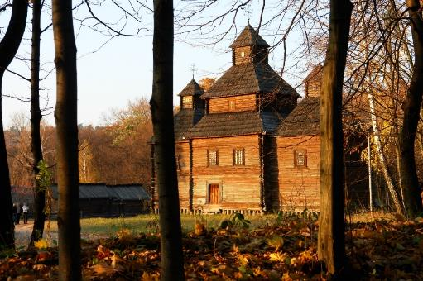
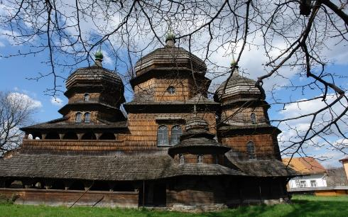
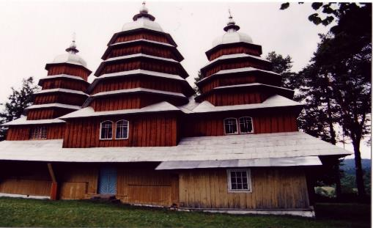
Ukrainian wooden churches of Vorokhta, Kysorychi, Drohobych and Matkiv

Slide 4
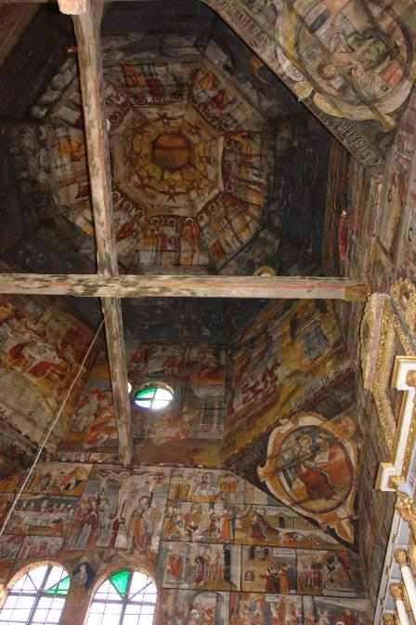
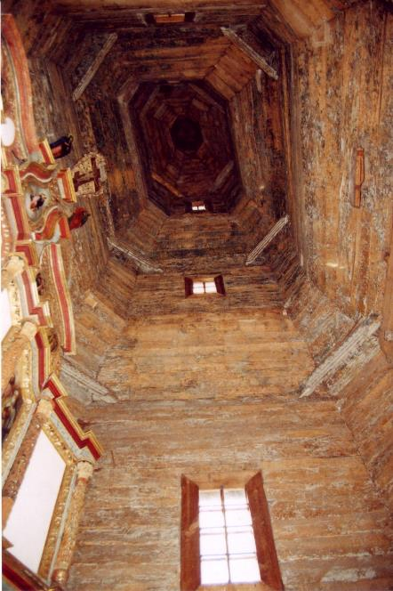
Inner space
of Ukrainian
Wooden church.
Drohobych and
Zarubintsi
churches

Slide 5









A
B
Basic types of Ukrainian wooden church’s log-towers space constructions:
A – simple archaic initial types (from left to right):
variations of raised longitudinal type, pyramidal type, variations of octagon-on-cube type;
B – complicated novel types (from left to right):
variations of zalom tiered type, the mixt between octagon-on-cube and zalom.

Slide 6
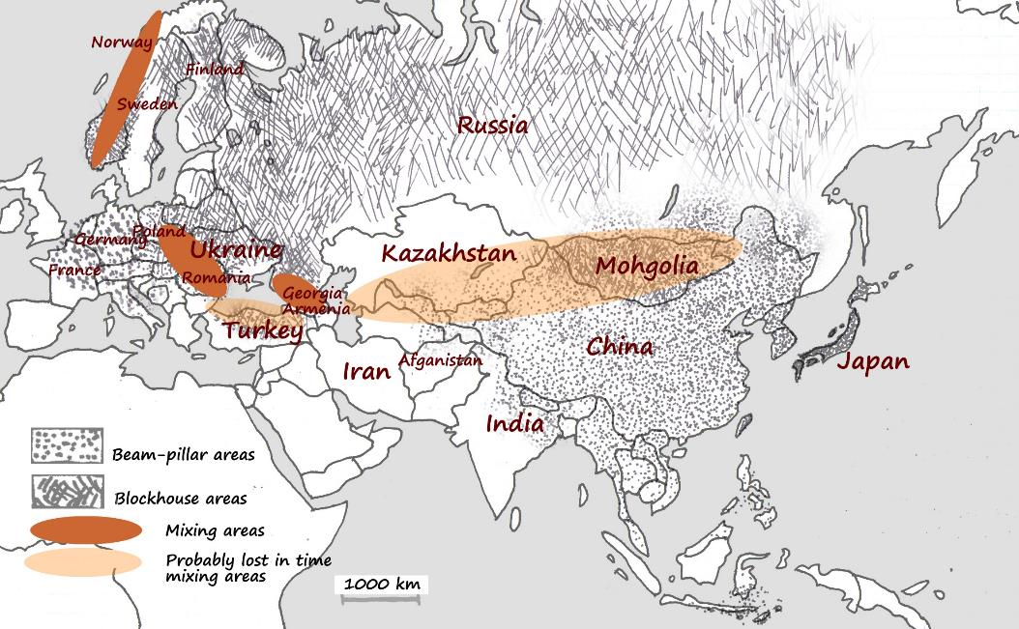
Beam-pillar and blockhouse wooden constructions spreading in Europe

Slide 7
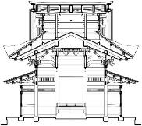
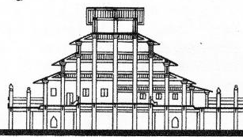
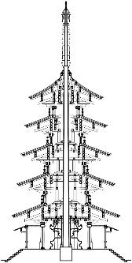
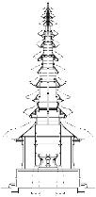
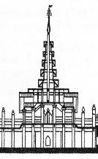
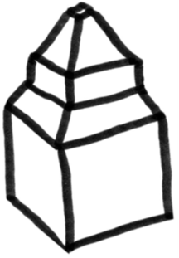
Far East and South-East Asian temple pavilions
compositional
analogies
constructive
analogies
A
B
Japanese and Chinese pagodas, sacral towers of Myanmar and Bali

Slide 8
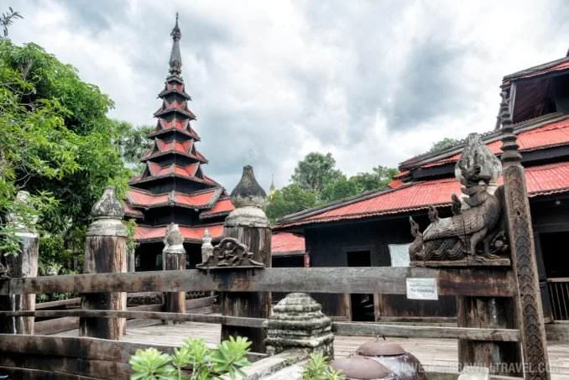
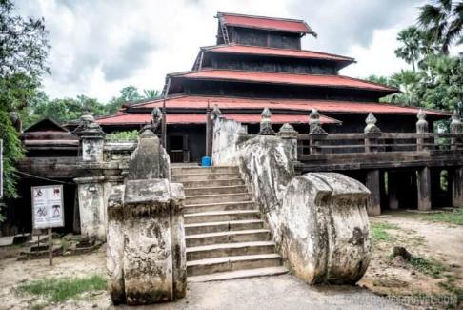
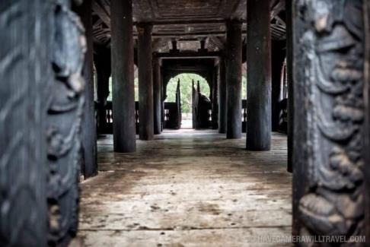
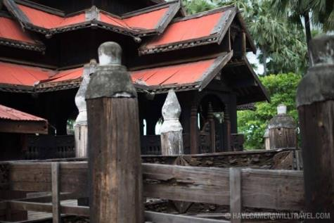
Wooden temples of Myanmar. Bagaya Monastery at Amarapura

Slide 9
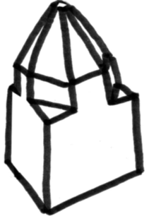
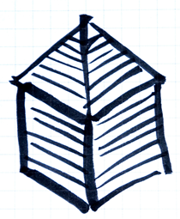


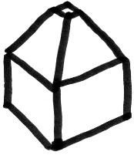






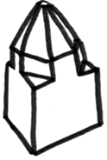



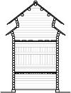
compositional
analogies
constructive
analogies
Caucasian pyramidal roofing
A
Russian centric churches
B
Russian longitudinal churches
C

Slide 10
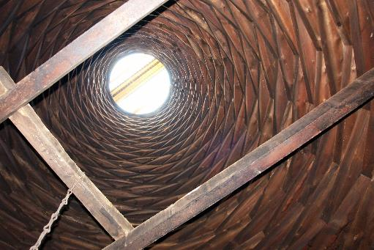
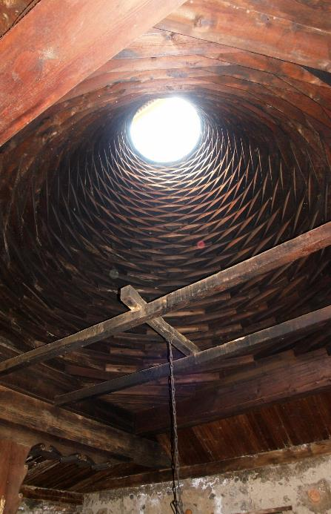
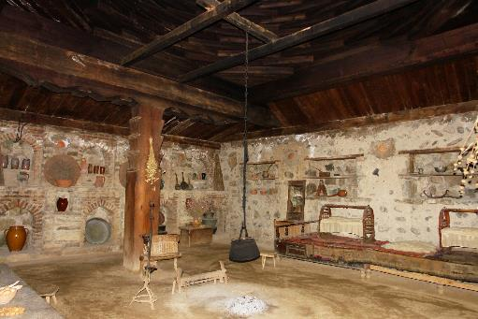
Georgian
Darbaza dwelling

Slide 11



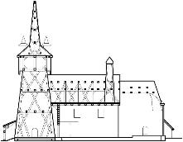
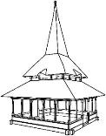


compositional
analogies
constructive
analogies
Romanian churches with raised longitudinal roofing
A
Carpathian churches with rafter roofs
B
Romanian sacral pavilions with pyramidal roofing
C

Slide 12
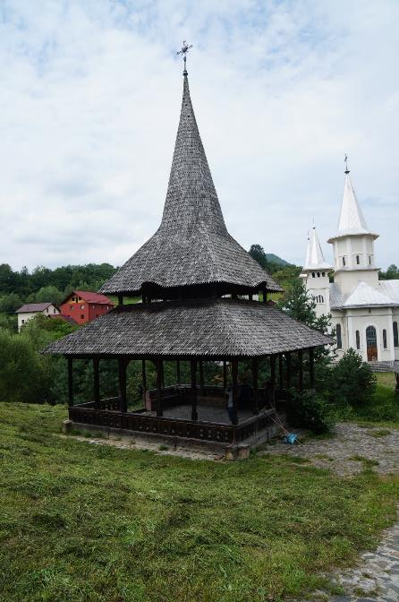
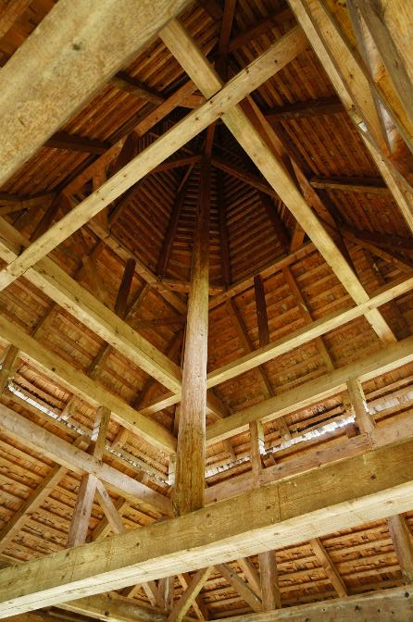
Romanian
wooden sacral
pavilions
Poienile Izei
Village,
Maramuses

Slide 13
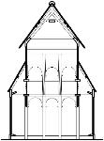
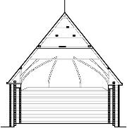
compositional
analogies
constructive
analogies
Stave churches of Norway
A
Buttress-pier churches of Finland
B

Slide 14
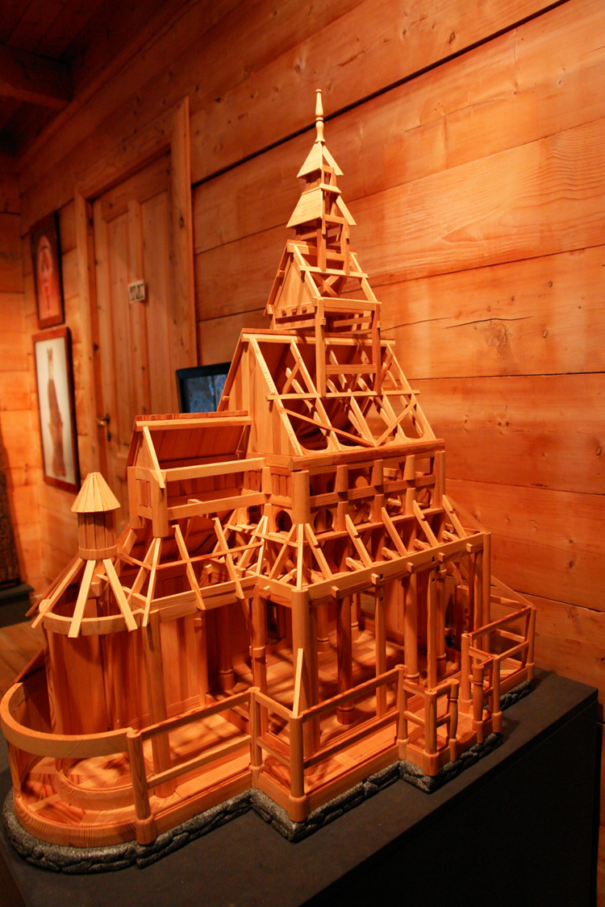
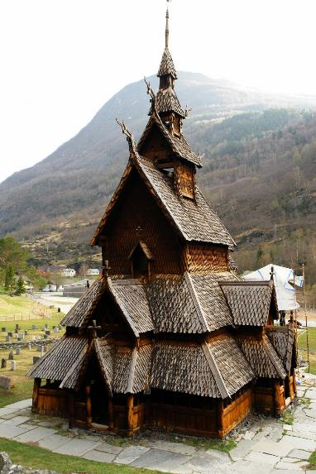
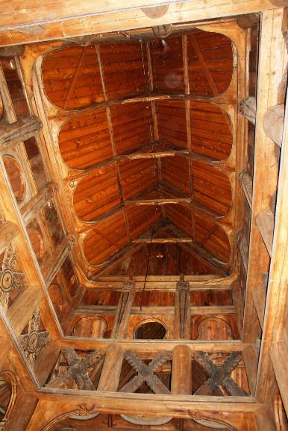
Wooden stave churches of Urnes, Borgund and Gol, Norway

Slide 15
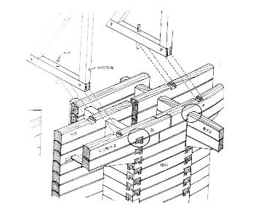
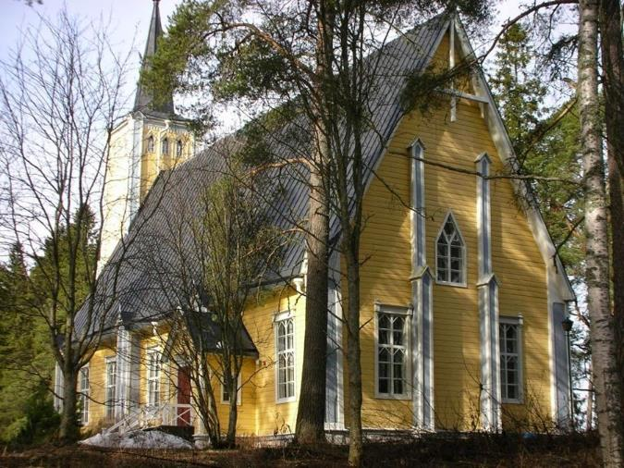
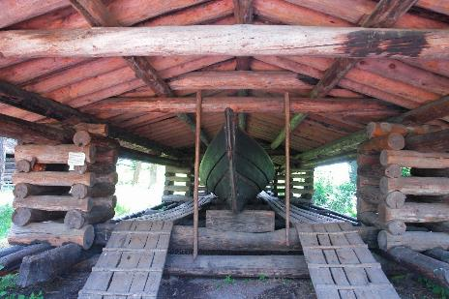
Wooden buttress-pier churches of Finland and their probably prototype
Buttress-pier construction
Muhos church
Traditional boat store place

